Slide 1
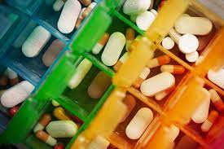
Predicting patient’s condition and medicine recommendation based on Drug reviews.
Deeksha Shetty

Slide 2


Project Brief
Project Summary
In this dataset, customers express their opinions on the drugs used to treat a particular condition
Drug Reviews: A wealth of information, could be leveraged for valuable insights to drug users and health care professionals
This project aims to perform NLP in supervised learning to classify the patient’s condition and recommend suitable drug based on the reviews.

Slide 3

Project Brief
Example
Review: "This is my first time using any form of birth control. I&#039;m glad I went with the patch, I have been on it for 8 months. At first It decreased my libido but that subsided. The only downside is that it made my periods longer (5-6 days to be exact) I used to only have periods for 3-4 days max also made my cramps intense for the first two days of my period, I never had cramps before using birth control. Other than that in happy with the patch"
Condition: Birth control
Drug Recommendation: Lybrel, Ortho Evra, Junel 1.5 / 30
(based on rating and usefulCount)

Slide 4

Project Brief
Objectives
Crawl the online pharmaceutical review sites using Selenium and Beautiful Soup.
Built classification models including random forest, XgBoost, Passive aggressive classifier using Bag of word and TF-iDF features as input.
Identify the model with best accuracy and further recommend suitable drug for the predicted condition.
Built a portfolio website using Flask or Django.

Slide 5



Project Brief
Status
Crawl online pharmaceutical website
Build machine learning models
Predict conditions and drugs via review
Built portfolio website

Slide 6
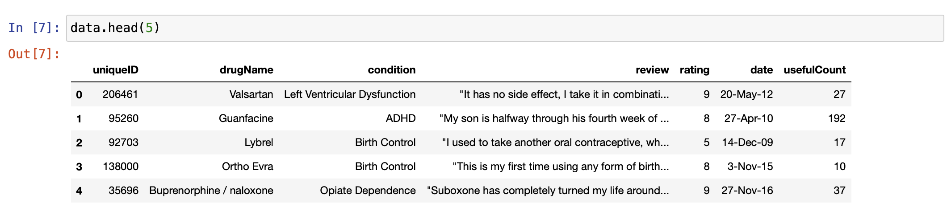

UCI ML Drug Review dataset (Kaggle)

Slide 7
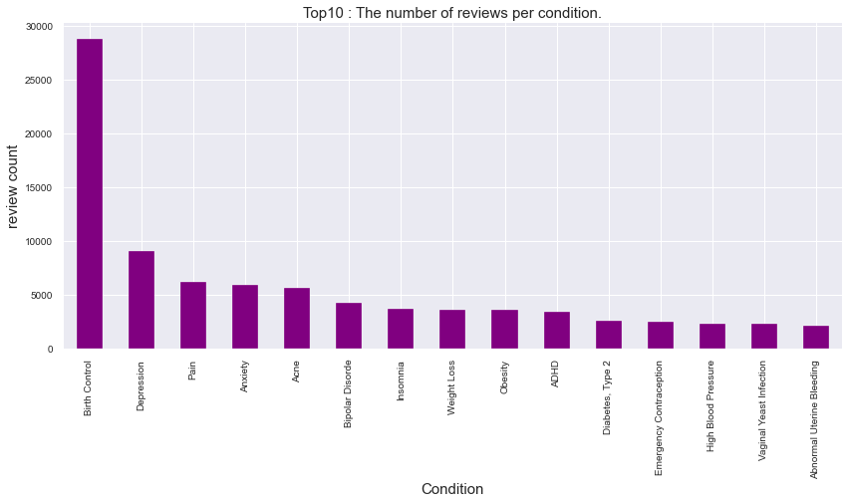
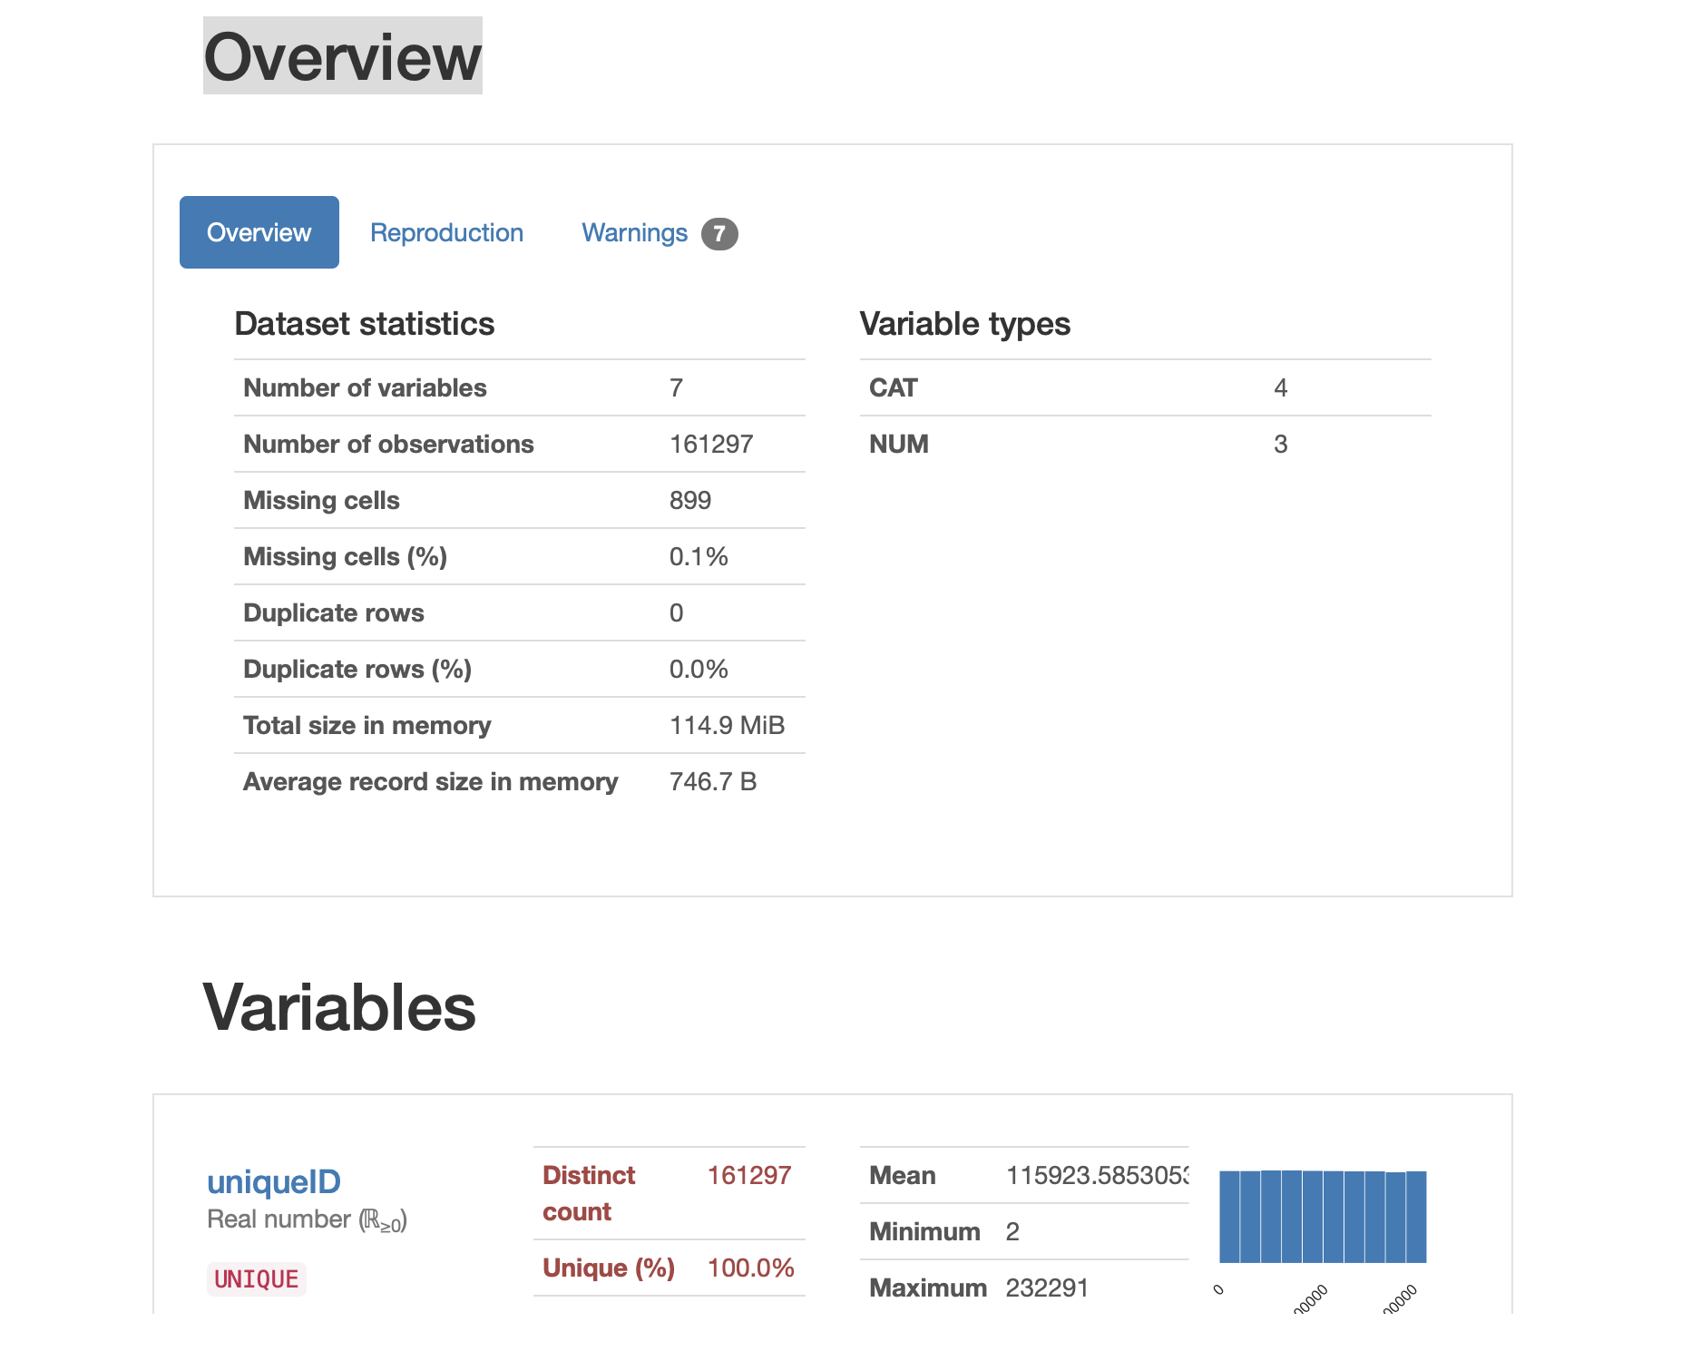

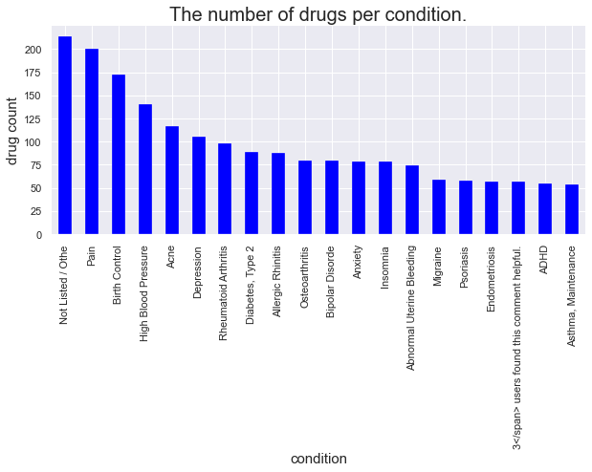
UCI ML Drug Review dataset (Kaggle)
EDA
Exploratory data analysis:
Pandas-profiling was performed to get a quick understanding of dataset.
Missing values (899) were observed in condition features.
In some cases, more than 1 drug was used to treat 1 condition
Highest reviews were recorded for Birth control, Depression, Pain, Anxiety, Acne and Bipolar Disorder.
The number of reviews were recorded from 2008-2017. Highest recordings are from 2016.
Review columns requires preprocessing.

Slide 8

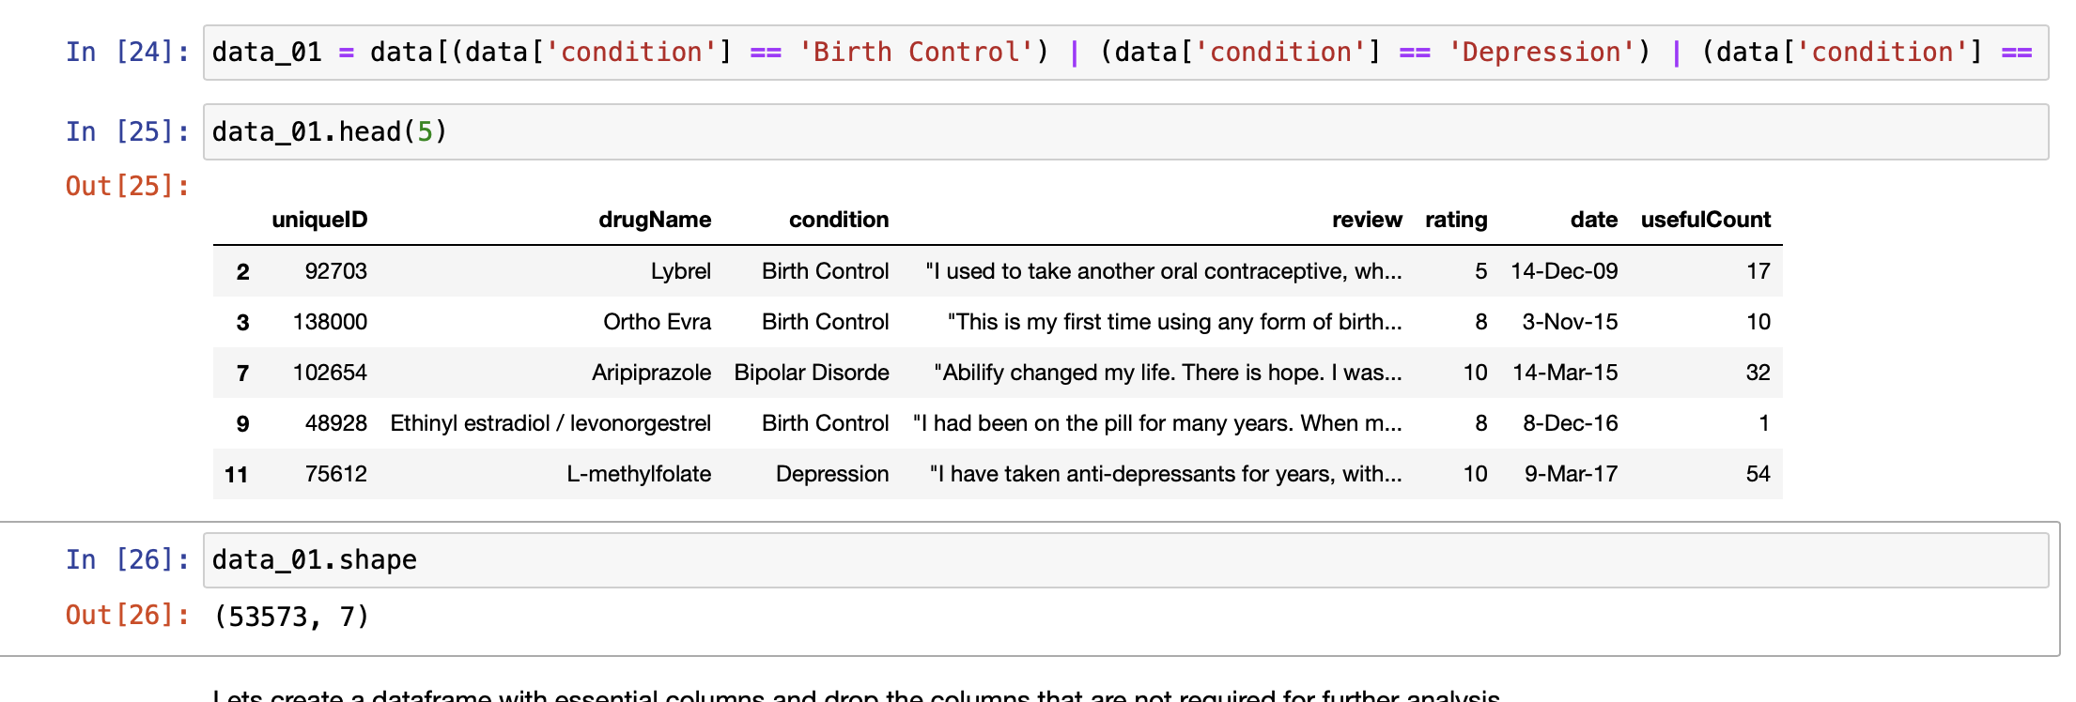
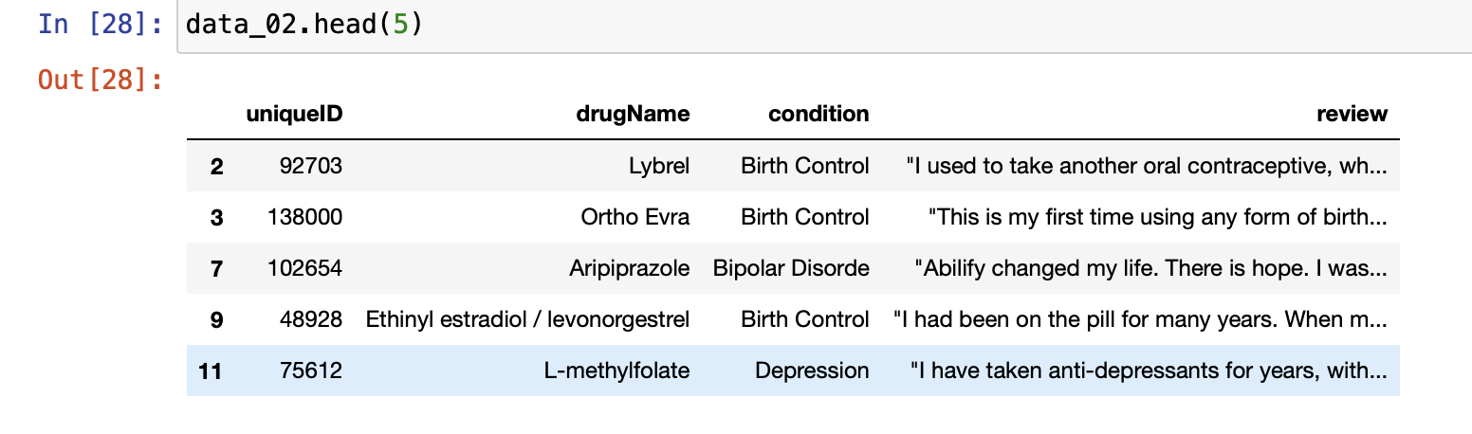
UCI ML Drug Review dataset (Kaggle)
EDA
Data selection
5 conditions were selected based on the reviews and the drugs associated with these conditions.
Birth control
Depression
Acne
Anxiety
Bipolar Disorder
Features selected:
drugName
Condition
Review

Slide 9

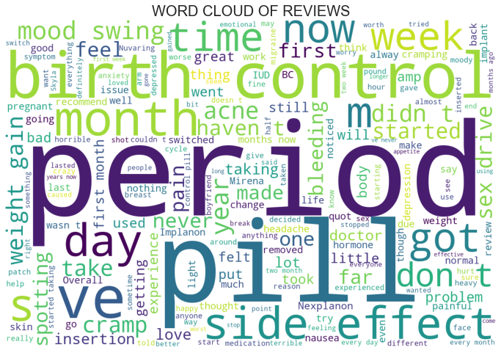
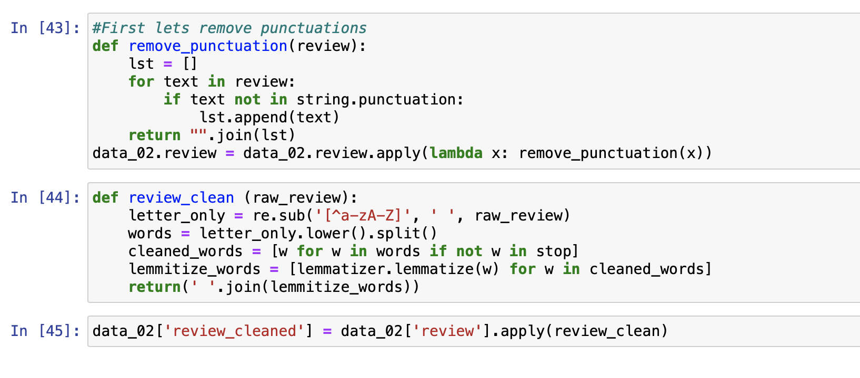
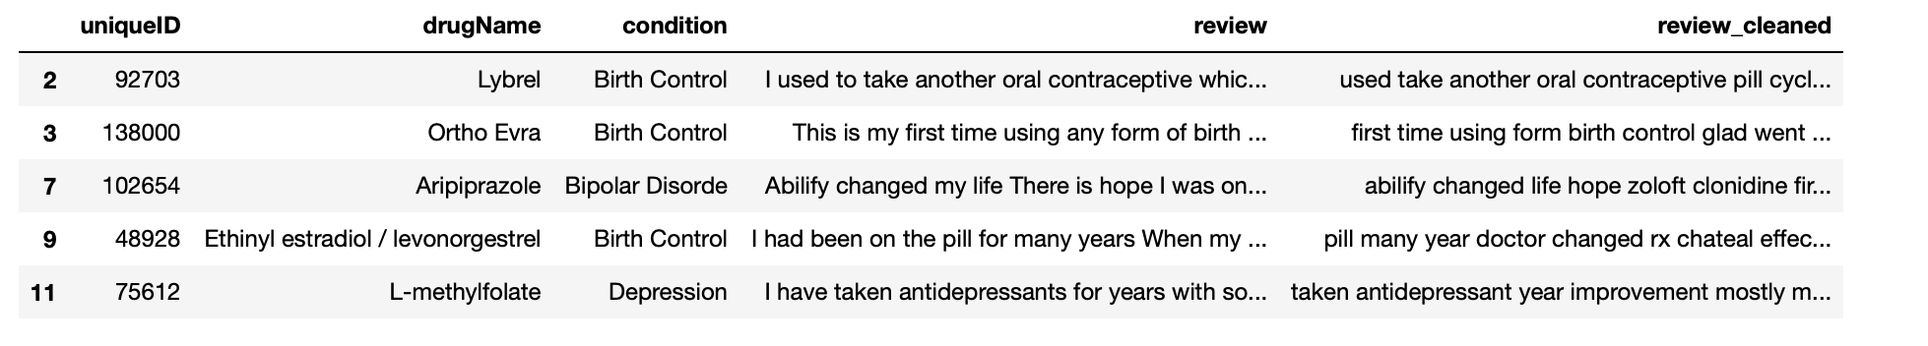
UCI ML Drug Review dataset (Kaggle)
EDA
Data selection
Data pre-processing
Cleaned review: Remove punctuations, special characters, stop words, lemmatization and lower case all reviews
Word cloud of reviews for birth control

Slide 10
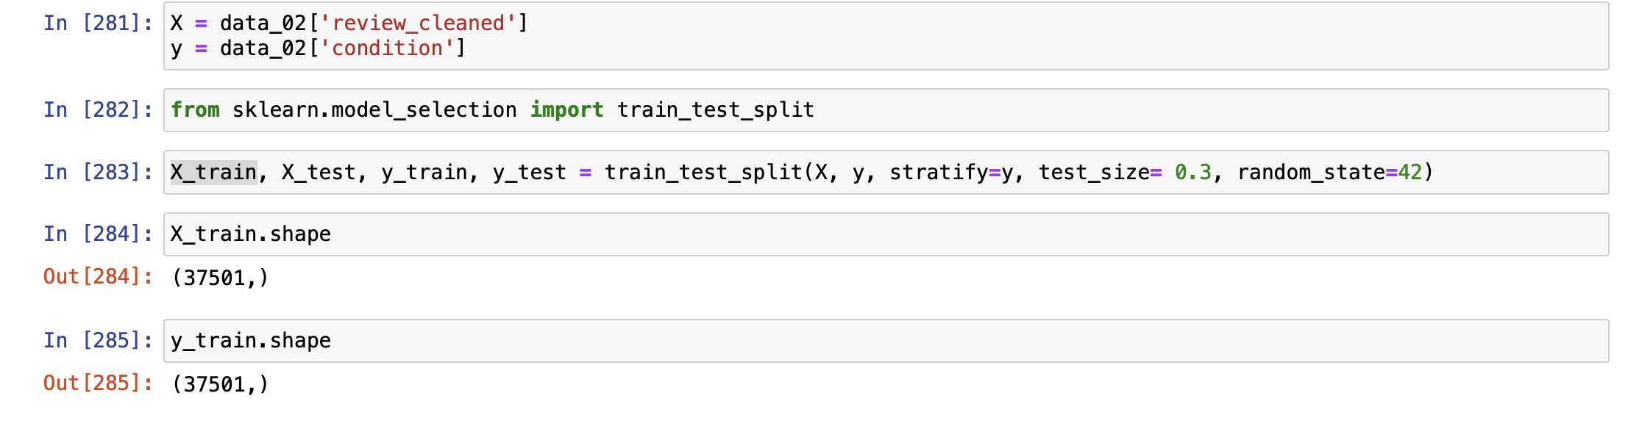
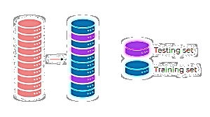
UCI ML Drug Review dataset (Kaggle)
EDA
Data selection
Data pre-processing
Train-test split

Slide 11
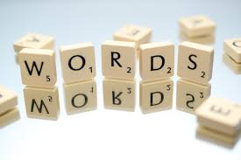
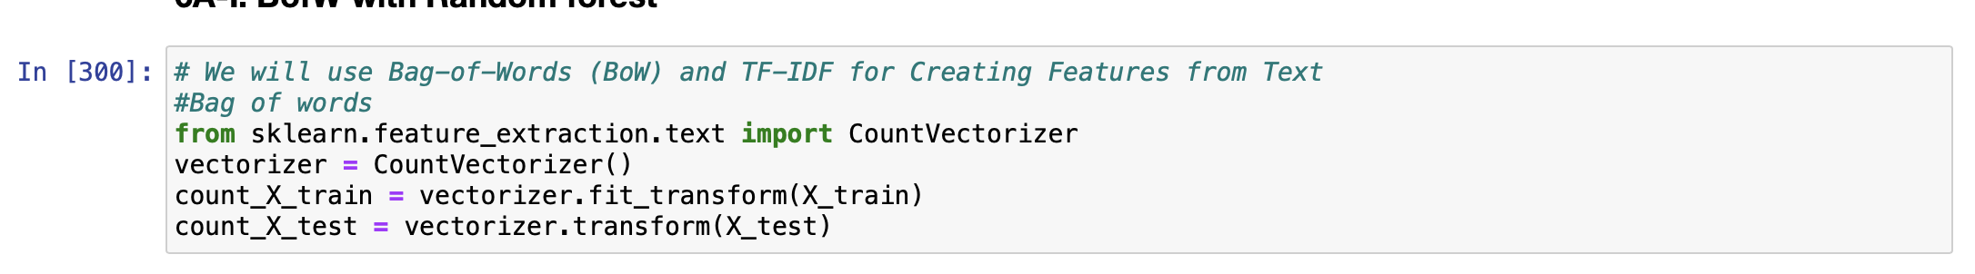
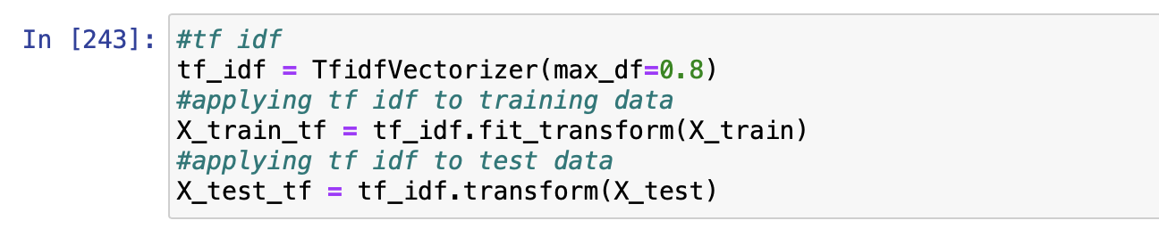
UCI ML Drug Review dataset (Kaggle)
EDA
Data selection
Data pre-processing
Vectorization :
Bag of Words
TF-iDF
Train-test split

Slide 12

UCI ML Drug Review dataset (Kaggle)
EDA
Data selection
Data pre-processing
Machine learning models
Vectorization :
Bag of Words
TF-iDF
Train-test split

Slide 13
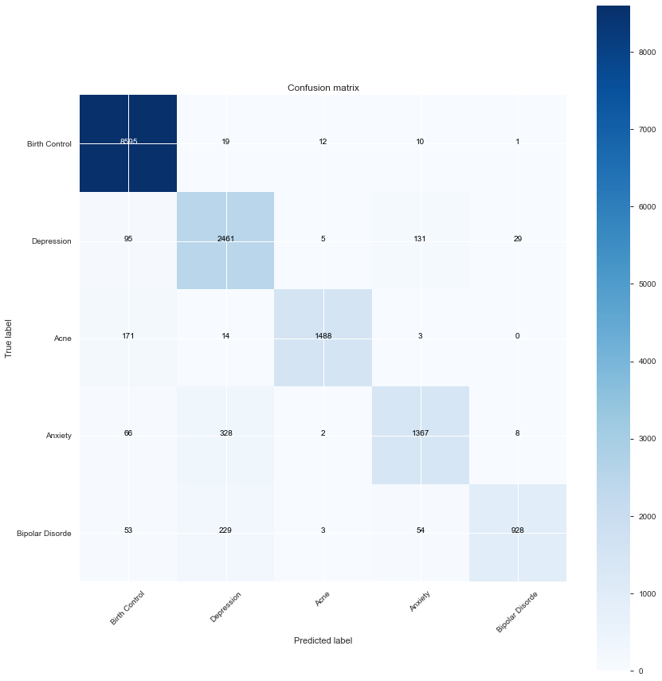
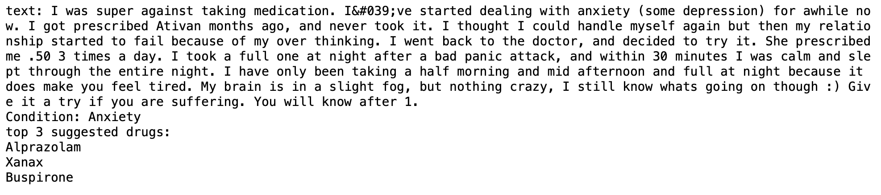
 | Bag of Words | Bag of Word (bigram) | TF-iDF | TF-iDF (bigrams)
Random forest | 92.428 | 88.308 | 92.32 | 91.0
XGBoost | 91.2 | 91.2 | 89.6 | 89.6
Passive Aggressive Classifier | 91.2 | 89.5 | 89.6 | 89.4
Accuracy score for each model.
Medicine Recommendation
Confusion matrix for each model

Slide 14
Summary
This project covered the classification of patient’s condition based on their reviews and predict 3 top suitable drugs (based of top rating and useful count).
The most successful model was Random forest using bag of words vectorization with accuracy of 92.428 %.
Limitation:
Only 5 conditions were taken into consideration, hence the ability for large class identification is unknown.
Accuracy could be improved by tuning the model.
Future work:
Crawl online pharmaceutical platform to extract recent reviews
Expand the model for multi-class classification in the identification of highly negative reviews.
Application of model to identify adverse effects for medication.

Slide 15


Thank you for listening!

